Slide 1
Emilie Lalonde,
Account Executive,
Carers UK
Recognising your Rights
November 21, 2024

Slide 2
Objectives
Discuss the rights of carers in:
Society
Employment
Understand carers protective rights under the Equality Act
Explore the case for making caring a protected characteristic
Highlight support

Slide 3
Carers rights

Slide 4
The Care Act
The Care Act 2014 is mainly for adults in need of care and support, and their adult carers.
Under the Care Act, you are entitled to a carer’s assessment where you appear to have needs for support. You will be entitled to this support if you meet the national eligibility criteria.
The person you care for is entitled to a ‘needs assessment' if they appear to have needs for care and support.
The wellbeing principles form part of the eligibility criteria. Local authorities must consider the impact of your role as a carer on your wellbeing consider the impact of a disabled person's needs on their wellbeing proactively.
Notes:
The Care Act 2014 came into effect in April 2015 and replaced most previous laws regarding both carers and people being cared for. The Care Act is mainly for adults in need of care and support, and their adult carers.
The Care Act 2014 sets out national eligibility criteria for both carers and the person being cared for. These criteria set a national minimum threshold to be met, and if a carer or the person being cared for meets this threshold, they will have eligible needs that the local authority must then meet.
Local councils have a legal duty to carry out a needs assessment once they become aware of a person’s potential needs for support and carers assessments can be requested alongside the needs assessment (same or different time)
The Care Act places a general duty on local authorities to promote an individual’s ‘wellbeing’. This means that they should always have a person’s wellbeing in mind when making decisions about them or planning services.
Wellbeing can relate to:
personal dignity (including treatment of the individual with respect)
physical and mental health and emotional wellbeing
protection from abuse and neglect
control by the individual over day-to-day life (including over care and support)
participation in work, education, training or recreation
social and economic wellbeing
domestic, family and personal relationships
suitability of living accommodation
the individual's contribution to society.
If the impact is significant then the eligibility criteria are likely to be met.

Slide 5
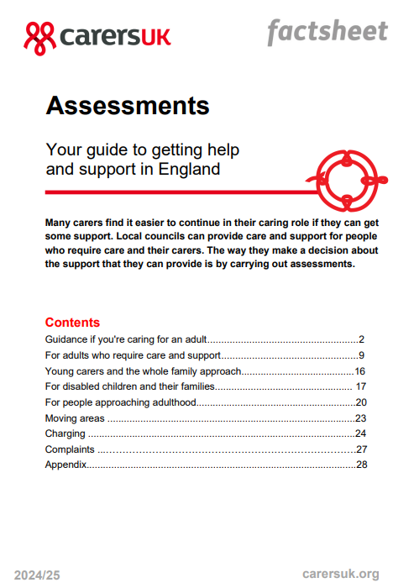
Arranging an assessment
Contact the local council social services department of the person you look after by phone, in writing or on-line.
The assessment will last at least an hour.
You can ask to have someone with you such as the person you care for, a friend or relative.
Tips to help you prepare:
Make a list of the different ways you are providing support (e.g., offering emotional support, managing finances).
Consider how caring affects your life
If the person you care for will be present at the assessment, will you be able to speak freely about any difficulties you have?
Notes:
You can ask for a carers assessment by contacting the local council social services department of the person you look after by phone, in writing or on-line. If you’re a carer for your child, contact the children with disabilities department.
Make a list of the different ways you are providing support (e.g., offering emotional support, managing finances, helping someone with practical activities such as shopping, or helping with personal needs such as using the bathroom).
Does it affect your emotional wellbeing – for example, do you often feel drained or lonely?
Does it affect you physically – for example, do you lose sleep or get back ache from lifting someone regularly?
Has it affected your work, social life or education?

Slide 6
Protection from discrimination
Nine protected characteristics in the Equality Act 2010
Associative discrimination with any protected characteristic (s. 13, Equality Act 2010)
Person (A) discriminates against another (B) if, because of a protected characteristic, A treats B less favourably than A treats or would treat others.
The Equality Act protects carers from direct discrimination or harassment because of their caring responsibilities:​ ​
Carers should NOT be treated unfairly or subjected to harassment​ ​
Carers SHOULD have fair treatment

Slide 7
Experience of carers
Our State of Caring research found that carers experienced unfair or unfavourable treatment in employment and when accessing goods/services.
A fifth of carers (19%) said they had been treated unfairly or unfavourably by the general public.
55% of carers need better understanding and recognition of unpaid carers from the general public.
Notes:
Carers UK research suggests that carers often feel invisible, overlooked and undervalued.
55% of carers need better understanding and recognition of unpaid carers from the general public.
for example, NHS Trusts must involve carers when plans for a patient’s discharge are being made. However, many carers are unaware of this right, and many are not consulted during the discharge process. Carers UK research in 2023 found that 36% of carers who had experienced hospital discharge disagreed they were involved in decisions about discharge, and 60% disagreed they were asked about their ability and willingness to care.3

Slide 8
Campaign to make caring a protected characteristic
Making caring more visible
Better understanding from the public
More people identifying themselves as carers
Ensuring fair treatment for carers
Introducing carer-friendly policies
Public bodies considering carers when reviewing support services

Slide 9
Recognise
your rights
at work

Slide 10
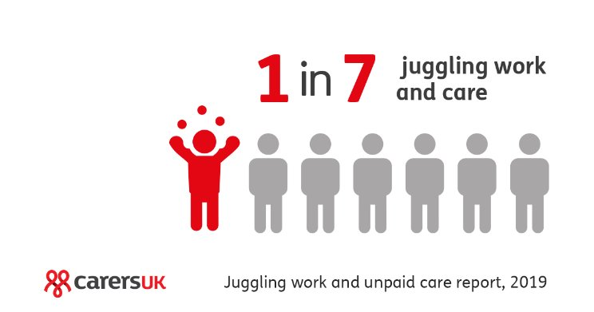
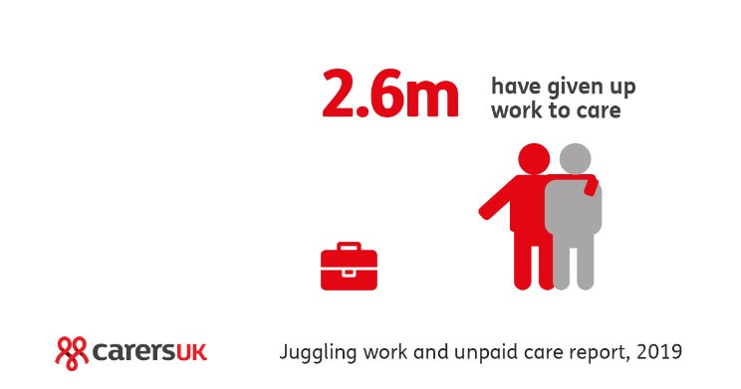
Impact of caring
There is evidence that carers (if unsupported) are working below their potential, reducing hours or giving up career opportunities
Carers are twice as likely to suffer from stress (if unsupported) and it is the key reason carers give up work or reduce working hours
600 carers a day give up work to care with a big impact on staff retention across the labour market

Slide 11
Getting support at work:
Legal rights for carers
Right to time off in emergencies to care for dependants
Right not to be discriminated against or harassed because of association with disability or age (Equality Act 2010)
Right to request to flexible working - Employment Relations (Flexible Working) Act
Parental leave and shared parental leave (April 2015)
Carer’s Leave Act 2023 – new right to take up to five days’ unpaid leave to care for planned or forseen commitments
Notes:
A bit about Carers UK

Slide 12
Protection from discrimination at work
Equality Act 2010
​
Carers should NOT be treated unfairly (differently to other workers) or subjected to harassment​ e.g. by not being offered a job, or promotion, or a training opportunity because of their caring responsibilities​ ​
Carers SHOULD have fair treatment and access to equal career opportunities​ e.g. carers often have strong talents and skills and don’t want to be disadvantaged due to caring - training and new roles should therefore be offered flexibly so they don’t miss out​
​

Slide 13
Flexible Working
Employment Relations (Flexible Working) Act 2023
New requirements for employers to consult with employee before rejecting their flexible working request​
​
Permission to make two statutory requests in any 12-month period (rather than the current one request)​
​
Reduced waiting times for decisions to be made from three months to two months​
​
Removal of existing requirements that employee must explain what effect, if any, the change applied for would have on the employer and how that effect might be dealt with​
​
​

Slide 14
Carer's Leave Act 2023
New right to take up to five days’ unpaid leave to provide or arrange care for a dependant with a long-term care need
Available from first day of employment​
Leave can be taken flexibly for planned and foreseen caring commitments​
Rights to: return to the same job, same terms and conditions and protection from dismissal or any detriment because of taking leave

Slide 15
Accessing support​

Slide 16
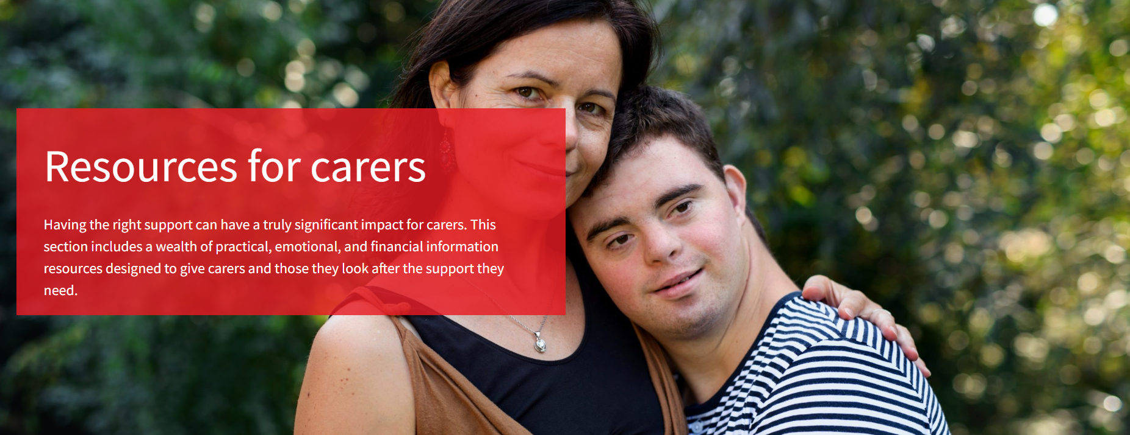
Local support
The Carers Centre for Brighton & Hove: provide family carers with emotional support, advice and a well-deserved break from their caring role. Visit: www.thecarerscentre.org
Carers UK works with Brighton & Hove Council and Carers Centre to provide free access to a range of digital resources, to support carers in the region. To access a range of digital resources:
- Head to efcdigital
- Enter code: #EFC1498

Slide 17
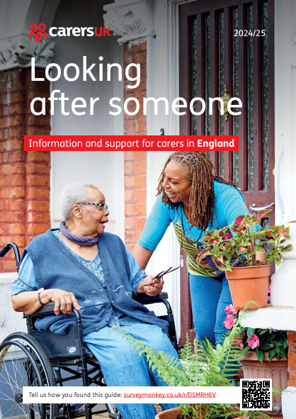
Carers UK Support
Get in touch with us, no matter where you are
Use our website at www.carersuk.org to find information on support
Our Helpline is available from Monday to Friday 9am – 6pm or you can contact us by email: advice@carersuk.org
Connect with others - get support and advice from other carers through Carers UK’s online forum and regular Care for a Cuppa sessions
Looking after Someone – information and support
Guide outlines your rights as a carer and gives an overview of the practical and financial support available.
Notes:
Our online Carers UK Forum is a great way to hear what other carers think of different ideas or to seek solutions to problems. It also offers the chance for you to 'offload' and get emotional support if your circumstances are becoming particularly tough. Self-advocacy is about speaking up for yourself. It’s about getting your voice heard and effectively communicating your own interests. Our guide has been designed to help you communicate your needs with professionals, understand your rights and look after your wellbeing.

Slide 18
Self-advocacy
Self-advocacy is about being heard as well as speaking up for the person you care for.
Our self-advocacy guide and video presentation provides practical guidance on how to get your voice heard when you care for someone in what may be complicated and challenging circumstances.

Slide 19
Contact:
Our telephone helpline is available
on 0808 808 7777
from Monday to Friday, 9am – 6pm.
Email at advice@carersuk.org
www.carersuk.org
www.jointlyapp.com
www.employersforcarers.org

