Slide 1
Carers Strategy development THINK CARER – building a Carer Friendly City
21.11.24
Carers Rights Day
Gem Scambler
Commissioning Manager, Housing, Care and Wellbeing

Slide 2
Last years Carers Rights Day
We discussed the Carers Friendly City Strategy development, discussed the 4 pillars of the strategy:
Carers Friendly Health; Education; Employment; and Social Care, plus we also talked about the importance of Integrated services.
Plus the priorities for the strategy:
Carer Registration (identification & carers offer);
Carer Engagement (co-production, carers voice, peer support);
Data Collection (including protected characteristics);
Integrated Services (ICS/HASC/Carers Hub/ and strategies);
Carer Awareness (training and support);
Carer Pathway (roadmap, signposting and policy);
Tackling Health Inequalities (influencing individual and system change);
Information, Advice, Assessment, and Support (proactive sharing of opportunities/rights/services)

Slide 3
Carers have told us…….
Improve Carer Awareness for staff working in Social Care; Health; Education, and for Employers to be aware of how caring affects carers.
Flexible supportive environments at work and in education.
Building stronger relationships with the services supporting the person you care for, recognise the expertise of the carer as part of the ‘team’.
For all services to help identify carers, and make sure they know where they can get support, and the importance of the carer being supported.
Access to services for the cared for and carer, respite and training
Help carers to ‘navigate’ the systems – whether health, or social care, or education .
Proactive contact, carers don’t generally seek support for themselves until a crisis hits.
Joined up services, don’t need to repeat everything, especially regarding consent and confidentiality.
Services for carers that value carers, including improving the Carers Card opportunities, etc.
Involve carers, co-production, in service developments

Slide 4
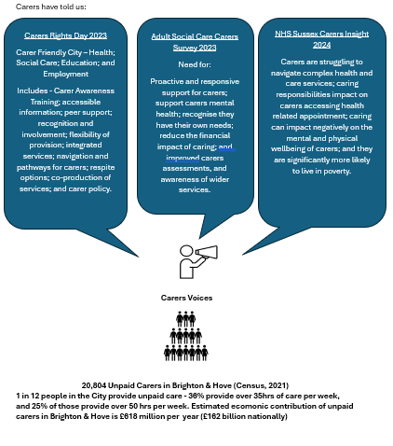

Slide 5
So what have we done……
We have produced a Carers Strategy Development Pack which pulls together - Progress on the previous Strategy Priorities; the main drivers for the new strategy – national and local (legislation and policies); Evidence base of what we know about carers locally, and the health inequalities they are facing (data, survey results, consultation); and What we are going to do to address the above (Carer Friendly Blueprints, Carers Hub, Support for carers) – will be on the BHCC website
We aim to launch the new strategy in the new year, which will be BHCC’s commitment to carers, and integrate with the wider systems within Sussex
We have recommissioned the Carers Hub for a further 6 years – BHCC had to retender the Carers Hub, which is jointly funded by NHS Sussex, and we redesigned the service to reflect the what carers have told us.
We have drafted Carer Friendly Blueprints and will be working with organisations/services across the City to encourage them to complete one, showing their commitment to carers. We will be developing ‘carer friendly’ badges for both these services, and those who provide a Carers Card offer.

Slide 6
New Carers Hub Contract from March’25
4 elements to the new Carers Hub:
Carer Representation – carer involvement, co-production
Carer Awareness – a programme of carer awareness linked to the ‘blueprints’
Carers Single Point of Contact – continuing the success of the current Hub, with added Carers Register; Proactive contact; integrated within key initiatives across the City, including the Integrated Care Teams, so clear pathways; Carers Offer (carers card, emergency back up, digital offer); Carers Assessments (link to BHCC);
Carers Dedicated Services – this includes Peer Support; Engagement; 1:1 support projects; volunteer support; with a focus on addressing the known health inequalities faced by carers.

Slide 7
The aim of the Carers Strategy – a Carer Friendly City 2025
– a City that:
Understands the needs of carers and the impact of caring
Encourages carers to speak about their experiences, recognising and valuing their contribution
Supports them in their caring role, as well as ensuring they have a life alongside caring
THINK CARER – see me, hear me, support me!
Supporting unpaid carers is everyone’s business, the City needs to Think Carer – reaching out to carers wherever we can by understanding the daily reality of caring, recognising that they are often under a lot of pressure and tend to be hidden from view. Through integrated, partnership working between key providers we can improve the lives of carers, assisting them to maintain a healthy lifestyle, and relationships with friends; balance work and caring; participate in education; access essential services for the person they care for, and themselves.

Slide 8
‘Blueprints’ for Carer Friendly Services
‘Blueprints’ or framework for Carer Friendly Services (cross reference with the 8 priorities):
Evidence base for addressing the needs of carers - local data and research of a carers profile which should include: Health inequality issues; Local research, data, recommendations; Local population data; and National data, for local assumptions
Available resources to support ‘carer friendly’ provision – what is known to improve outcomes for carers, which this service could utilise, work with carers through co-production
Commitment to carer - be clear about how your service will address the 8 priorities through these 3 areas: What are the legal Carers Rights in this service area? What should carers expect from the service area? How can carers feedback on their experience of how carer friendly the service is?
Measuring progress and adding to the evidence base – measure and evaluate the impact of the ‘commitments to carers’, and then feed that in as new evidence

Slide 9
Cycle of building a Carer Friendly City
resources for addressing the needs of carers
committment to carers
measuring and evaluting
evidence base for supporting carers

Slide 10
How can carers continue to be involved in the strategy?
Greater links between the Carers Voice group and the strategy group
Present CF Blueprints during Carers Week, to get feedback from carers
Respite development, involve carers within BHCC respite developments
Have greater contact with carers regarding feedback on issues, problems, and what is working well (via the Register)
Ensure that there are identified ‘navigators’ or ‘champions’ within services, these may also be carers.

